Slide 1
Chapter 10
Events in React

Slide 2
Objectives
Listening and Reacting to Events
Starting Point
Making the Button Click Do Something
Event Properties
More Eventing Shenanigans
Browser Compatibility
Improved Performance

Slide 3
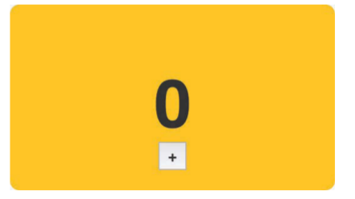
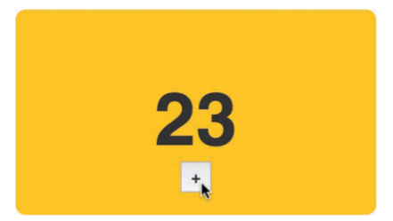
Listening and Reacting to Events
The easiest way to learn about events in React is to actually use them, and that’s exactly what you’re going to do here. To help with this, we have a simple example made up of a counter that increments each time you click a button.

Slide 4
Starting Point
Pages 108-110

Slide 5
Making the Button Click Do Something
Each time we click the plus button, we want the value of our counter to increase by 1. What we need to do roughly looks like this:
1. Listen for the click event on the button.
2. Implement the event handler so that we react to the click and increase the value of our this.state.count property that our counter relies on.
More specifically, you specify inside your markup both the event you’re listening for and the event handler that will get called.

Slide 6
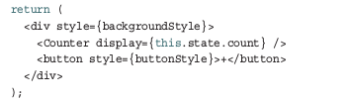
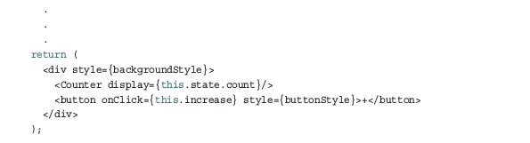
Making the Button Click Do Something
The return function inside our CounterParent component and make the following highlighted change:

Slide 7
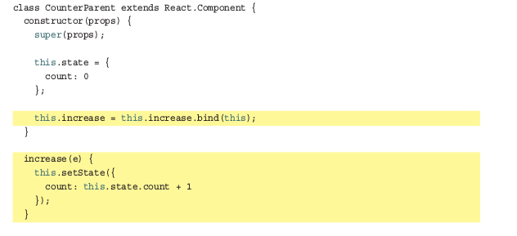
Making the Button Click Do Something
The increase function when the onClick event is overheard. Next, let’s go ahead and implement the increase function. Inside our CounterParent component

Slide 8
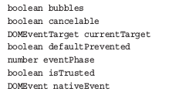
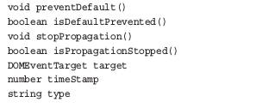
Event Properties
Meet Synthetic Events:
Each SyntheticEvent contains the following properties:

Slide 9
Event Properties
SyntheticEvent that wraps a MouseEvent will have access to mouse-specific properties such as the following:
boolean altKey number button number buttons number clientX number clientY boolean ctrlKey boolean getModifierState(key) | boolean metaKey number pageX number pageY DOMEventTarget relatedTarget number screenX number screenY boolean shiftKey

Slide 10
Event Properties
SyntheticEvent that wraps a KeyboardEvent will have access to these additional keyboard-related properties:
boolean altKey number charCode boolean ctrlKey boolean getModifierState(key) string key number keyCode | string locale number location boolean metaKey boolean repeat boolean shiftKey number which

Slide 11

Event Properties
Doing Stuff with Event Properties:
Right now, our counter example increments by 1 each time you click the plus button. We want to increment our counter by 10 when the Shift key on the keyboard is pressed while clicking the plus button with our mouse.

Slide 12
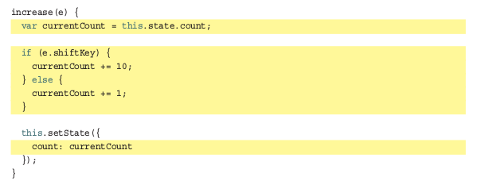
Event Properties
Otherwise, the shiftKey property value is false. To increment our counter by 10 when the Shift key is pressed, go back to our increase function and make the following highlighted changes:

Slide 13
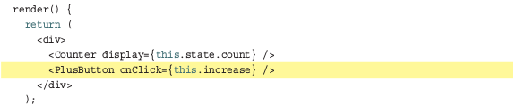
More Eventing Shenanigans
You Can’t Directly Listen to Events on Components
Let’s say your component is nothing more than a button or another type of UI element that users will be interacting with. You can’t get away with doing something like what we see in the following highlighted line:

Slide 14
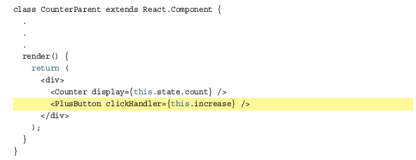
More Eventing Shenanigans
You Can’t Directly Listen to Events on Components
We can treat the event handler as a prop and pass it on to the component. Inside the component, we can then assign the event to a DOM element and set the event handler to the value of the prop we just passed in.

Slide 15
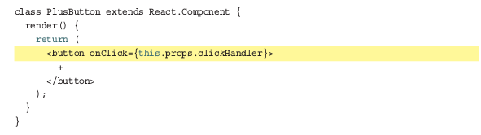
More Eventing Shenanigans
You Can’t Directly Listen to Events on Components
In this example, we create a property called clickHandler whose value is the increase event handler.

Slide 16

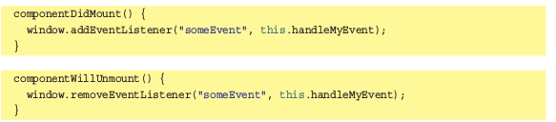
More Eventing Shenanigans
Listening to Regular DOM Events
Not all DOM events have SyntheticEvent equivalents.
Have to follow the traditional approach that uses addEventListener with a few extra hoops to jump through.

Slide 17
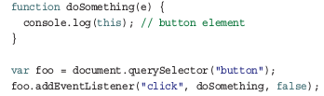
More Eventing Shenanigans
The Meaning of this Inside the Event Handler
When dealing with events in React, the value of this inside your event handler is different than what you normally see in the non-React DOM world.
Need to explicitly specify what this binds to using the bind method

Slide 18
React...Why? Why?
Why React decided to deviate from how we’ve worked with events in the past. There are two reasons:
1. Browser compatibility
2. Improved performance

Slide 19
Browser Compatibility
Event handling is one of those things that works consistently in modern browsers, but once you go back to older browser versions, things get really bad really quickly.
By wrapping all the native events as an object of type SyntheticEvent , React frees you from dealing with event-handling quirks.

Slide 20
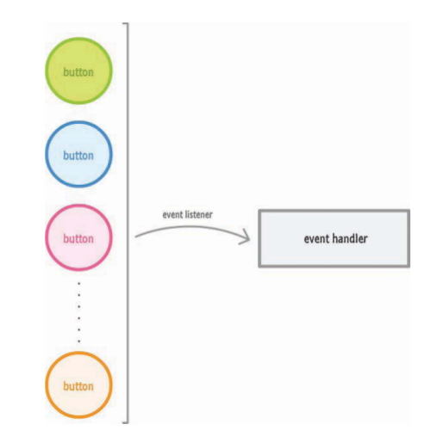
Improved Performance
React never directly attaches event handlers to the DOM elements. It uses one event handler at the root of your document that is responsible for listening to all events and calling the appropriate event handler as necessary

Slide 21
Conclusion
You’ll spend a good amount of time dealing with events, and this chapter threw a lot of things at you.
We started by exploring the basics of how to listen to events and specify the event handler.
Toward the end, we got fully invested and looked at eventing corner cases that you’ll bump into if you aren’t careful enough.

